Slide 1
HTML ELEMENTS
TYPES OF LISTS
COLORS

Slide 2
TAGS IN HTML:
<p>
<HR>
<blockquote>
<q>
<Pre>
<address>
<marquee>

Slide 3
<p>
This command creates a paragraph on web page , this paragraph takes space over and below the paragraph area.
Alignment of a paragraph on a web page is on the left side by default.
Use align attribute to change the default alignment of a paragraph.
align attribute has three values:
  Left
  Center
  right

Slide 4
<HR>
The HR element inserts a horizontal rule.
Attributes:
Width (in %)
Align(left , right , center)
Size( in numbers)
Color
The use of these attributes is deprecated. (Use CSS instead)

Slide 5
<blockquote>
The <blockquote> tag is used to highlight some special paragraph.
A browser inserts white space before and after a blockquote element.
  ^{<blockquote>}
  “When one door closes, another opens; but we often look so long and so regretfully upon the closed door that we do not see the one which has opened for us.” -Alexander Graham Bell
  ^{</blockquote>}

Slide 6
<q> Tag
The <q> tag defines a short quotation.
The browser will insert quotation marks around the quotation.
Example:
<q>
A quick brown fox jumps over the lazy dog”
</q>

Slide 7
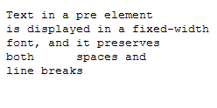
<PRE> Tag
The <pre> tag defines preformatted text.
<pre>
Text in a pre element
is displayed in a fixed-width
font, and it preserves
both spaces and
line breaks
</pre>

Slide 8

<address>
The address element is a container element,which encloses the address or contact information.
Such information appear in the beginning or at the end of the HTML page
<address>
Written by XYZ <br />
Address: Box 564, Disneyland<br />
Phone: +12 34 56 78
</address>

Slide 9
<marquee>
scrolling text
Example:
<marquee >scrolling text</marquee>
Attributes:
Width(in %)
Behavior(scroll, slide, alternate)
Loop(number)
Scrolldelay
  (high value=slow , low value = fast)
  Scrollamount(number)
Direction(left, right, up, down)

Slide 10
BODY TAG AND ITS ATTRIBUTES

Slide 11
<body bgcolor=“value” text=“value”>
By default web page has white page color. If we want to change the back ground color of a web page, we will use bgcolor attribute inside the body tag.
By default web page has black foreground color. If we want to change the foreground color of a web page, we will use text attribute inside the body tag.
  <body bgcolor=”color_name|hex_number|rgb_number”>

Slide 12
Playing with colors
Sometimes, you can specify the color by a color name.
There are 16 color names which are widely understood & interpreted by most of the browsers.
It is recommended to avoid using color names since not all browsers understand them. It’s much safer to specify colors using the RGB code.
Notes:
The 16 color names are BLACK, SILVER, GRAY WHITE , MAROON, RED, PURPLE, FUCHISA, GREEN , LIME, OLIVE, YELLOW, NAVY, BLUE, TEAL and AQUA.

Slide 13
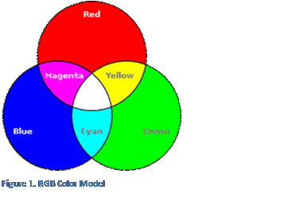
Playing with colors
Internet uses RGB color scheme.
The RGB color model produces color using combinations of the three primary colors- red, green, blue.
To generate a wider range of colors, vary the intensity of red, green & blue.

Slide 14

Color coding
To make any color code use the following characters/digits:
  0123456789abcdef
Color code consists of any 6 digit combination: e.g. #00ff80
First 2 positions represents intensity of red color .
Second 2 positions represents intensity of green color .
Last 2 postions represents intensity of blue color.
# represents hexadecimal number system.

Slide 15
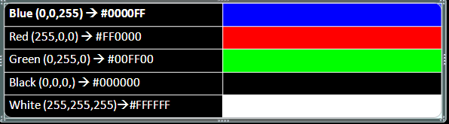
Playing with colors
In RGB model, the intensity value of each component range from 0 (absence of color)to 255(highest intensity).
Mostly, they are mentioned in hexadecimal format where the hexadecimal color code is preceded by a number sign (#).

Slide 16
Changing the color of text
Color name: | Specifies the text-color with a color name | <Body Text=“blue”>
Hex number: | Specifies the text-color with a hex code | <Body Text=“#0000ff”>
RGB number: | Specifies the text-color with an rgb code | <Body Text=“0,255,0”>

Slide 17
Using the FONT tag
<FONT> tag lets you specify how you want your font formatted on the Webpage.
<FONT> tag overrides the text color define in the body tag.
Attribute | Description
FACE | Specifies the type of font you want.
SIZE | Sets the size of text.
COLOR | Sets the color of text.

Slide 18
Using the FONT tag: FACE attribute
Used to specify the font to be used.
The font that you specify must be present on the user’s computer.
The default font face is “Times New Roman”
<body>
<font face=“algerian”>
i am enjoying html classes!
</font>
</body>

Slide 19
As value for the FACE attribute you can use any specific font name such as "verdana", "arial", "georgia", "bookman old style", "comic sans ms" and many more.
The font face values are case-insensitive, i.e. it doesn´t matter whether you type "Arial" or "arial".

Slide 20
Multiple Faces :
What if the user doesn’t have the font that we have specified?
Specify more than one fonts. The other fonts are used as alternatives, if the first choice is not available.
Each font face is separated by commas.
<BODY>
<FONT FACE=“ ali, Algerian, Sansserif”>
Using multiple choices in FONT tag
</FONT>
</BODY>

Slide 21
Using the FONT tag: SIZE attribute
HTML specifies text using point.
Smallest size is 1 & largest size is 7.
Default size is 3.
It is strange that HTML heading levels have 6 integral levels, while FONT SIZE has 7.
<body>
<Font Size=“5”>
this text is of size 5
</font>
</body>

Slide 22

Using the FONT tag: COLOR attribute
It simply sets the color of the text either by providing color name, or its hexadecimal code, or RGB color value.
<body>
<font color=“red”>
i am enjoying my html classes!
</font>
</body>

